Slide 1
SWM
2021 Capstone Design Project
Development of a communication app for study groups made in the local areas
Development of a communication app for study groups made in the local areas
Prof. Wooje Kim
16102272 Taehee Kim
16102284 Sungho Lee
17102055 Jeayun Eum

Slide 2

1. Motivation
2. Service Basic Concept
3. System Design
4. Functions
5. Conclusion

Slide 3
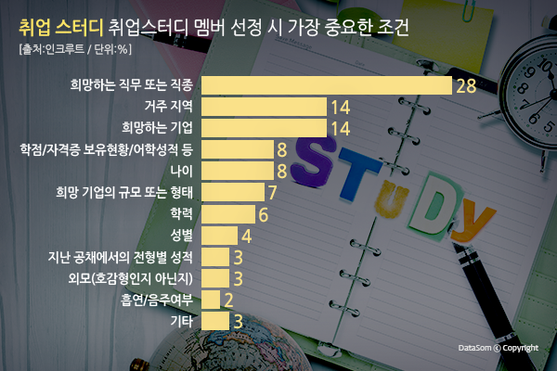
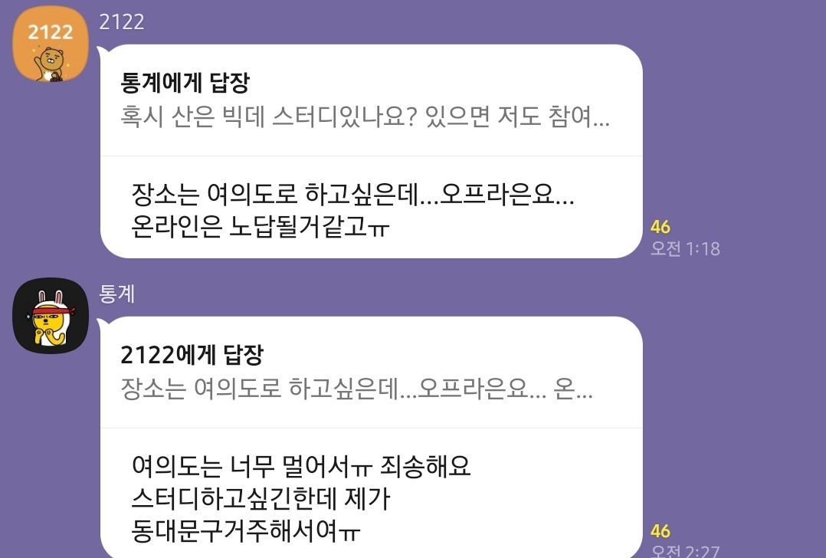
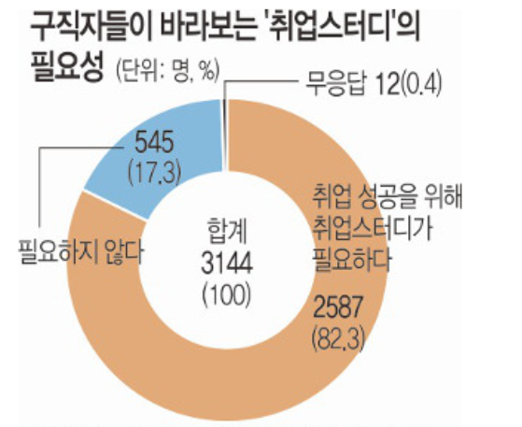
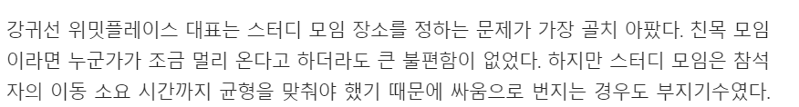
#1.
Market Analysis
Market Analysis
The necessity of job seeking study
82.3%
Due to the nature of the job seeking study, participants must move.
The difficulty of balancing locations by the travel time
Conditions for selecting participants job seeking study members
1. Desired Department/Occupation
2. Residence
3. company of the same family
The average number of times a month to attend job seeking study is 6.9 times.
Existing job seeking study: It is inconvenient to check the progress in real time after applying.

Slide 4
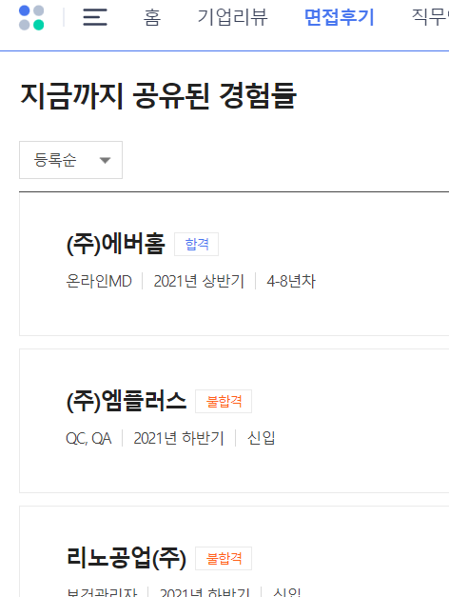
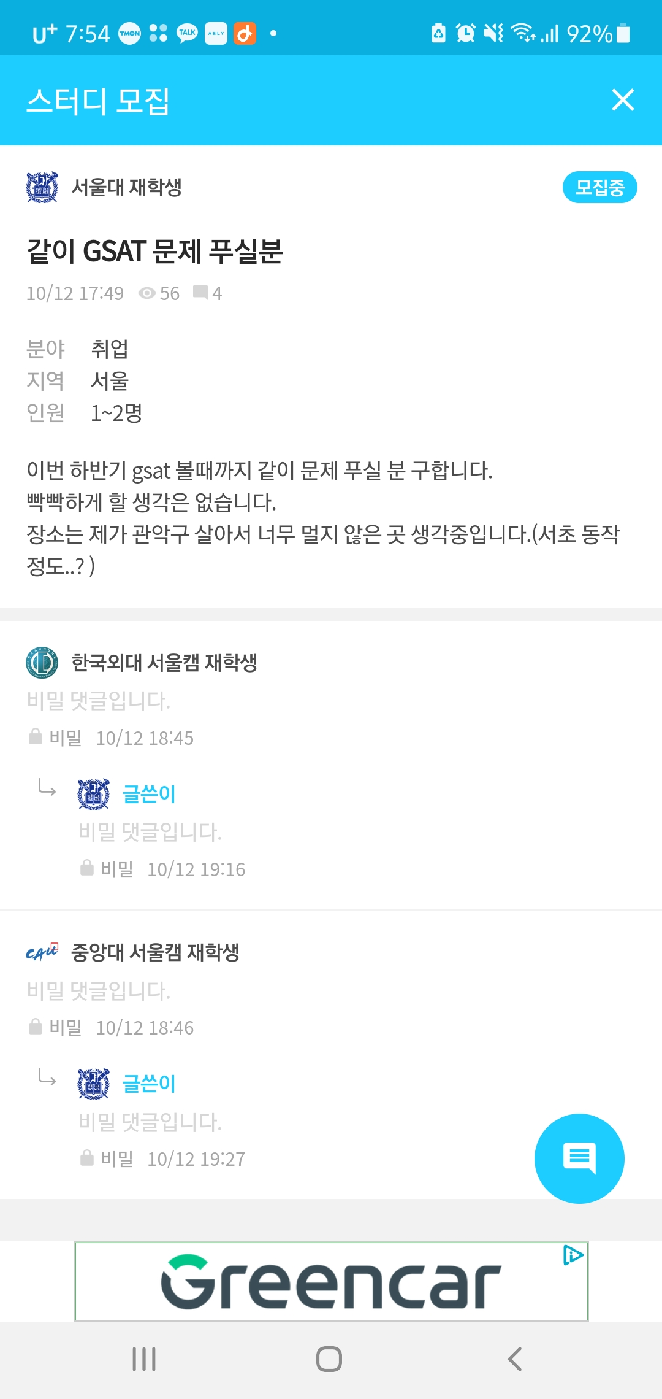
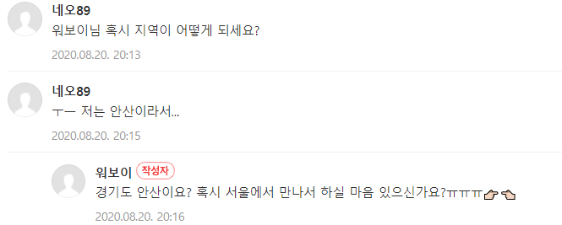
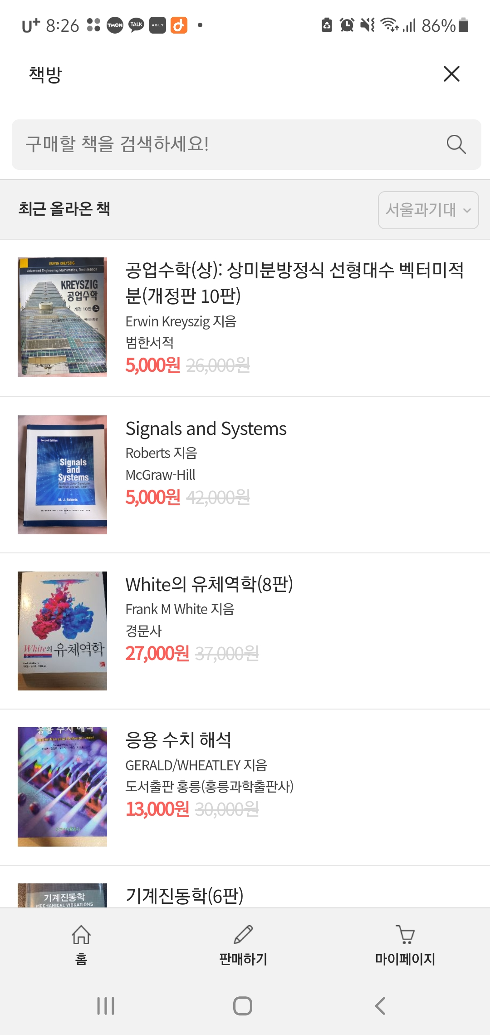
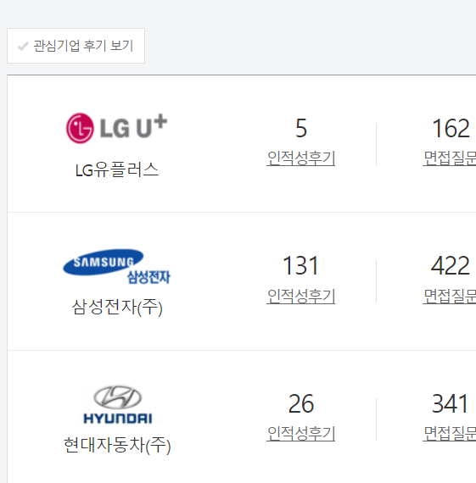
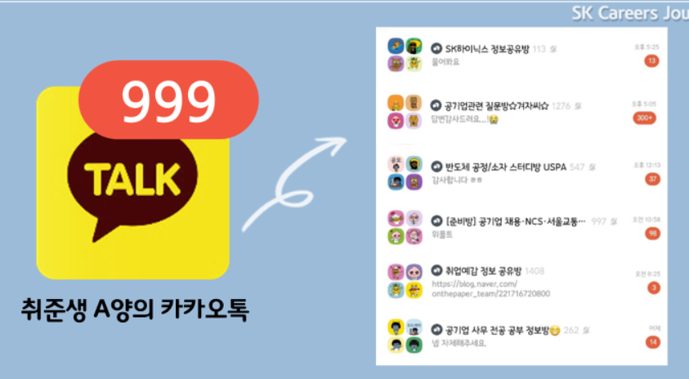
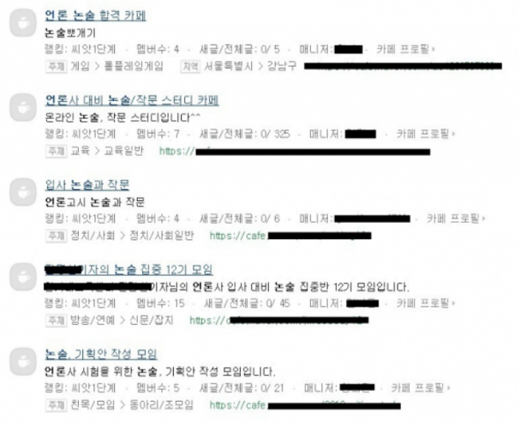
#2.
Competitor Analysis
Competitor Analysis
 | Kakao Talk open chat | Naver Cafe (독취사, 스펙업) | App (에브리타임, 캠퍼스픽) | Website (사람인, 잡코리아)
Main Function | For mutual communication | largest community Accumulated information/network | Anonymity verified by the name of the university Used book sale forum | Search job opening Interview & company reviews can be viewed.
Characteristic | The purpose of the chat is greater than the indiscriminate content/advertising recruitment | Current recruitment status unknown Complex participant invitation process | Only college students can participate Location-based recruitment available | Department/Occupation unknown Limited to public/major corporations
Notes:
밑에 필요성

Slide 5
#3.
Current Landscape(problem) Analysis
Current Landscape(problem) Analysis
 | Function | Description
User requirements | Offline job seeking study | On account of the sharpest drop as the coronavirus pandemic hammered job markets, many job seekers want to enter the job seeking study -> Tendency to still prefer face-to-face job seeking study.
 | Prefer mobile channels | Generation Z mainly use mobile channels to search for jobs.
 | Near location | Many job seeking study administers give up study due to restrictions on where participants live.
 | Study cafe | Simplify and visualize the study cafe selection process through the in-service using google map application
 | General & Functional integration platform | It is inconvenient because it is not possible to view the job seeking study post that are spread in various blogs and forums at once. Essential functions such as checking recruitment status and inviting chat after recruitment are distributed in various services.
 | Online chatting service | Existing platforms such as SNS, blog, and ‘캠퍼스픽’ do not work with chat services, so it is cumbersome to go through various complicated processes to move to messenger applications such as Open KakaoTalk and Line.
 | Service for buying and selling used stuff | Most job-seeking students feel burdened with the cost of purchasing books/materials/devices necessary for job preparation.
 | Pre-information about the interview. | Job seekers find it difficult to obtain reviews and information about the interview conducted when they are looking for a job.
Notes:
인터뷰나 설문조사 이런 거 필요

Slide 6
#4.
Service Basic Concept
Service Basic Concept
Reliability
Convenience & Hyperlocal
One-touch platform
Real-time location-based
Study matching with trusted nearby
neighbor users based on your current location
Realtime
Area
Simplify/Visualize Processes
Processes such as location selection / user invitation / recruitment status inquiry / chatting / schedule sharing are performed at once
One-Touch
Platform
Social
Community
Social community platform
Expansion into a continuous
community space after the study (Interview review/book/product transaction)
Various communication communities have been formed, but there is no 'integrated app’.
"Local-based" job seeking study platform(Study Recruitment + Interview Review + Seconds hand market)
Simplify and visualize the entire study process such as location/chat invitation/recruitment status inquiry
Notes:
앞에 페이지(유저 니드랑 연관지어서)

Slide 7


Notes:
1분 47초

Slide 8
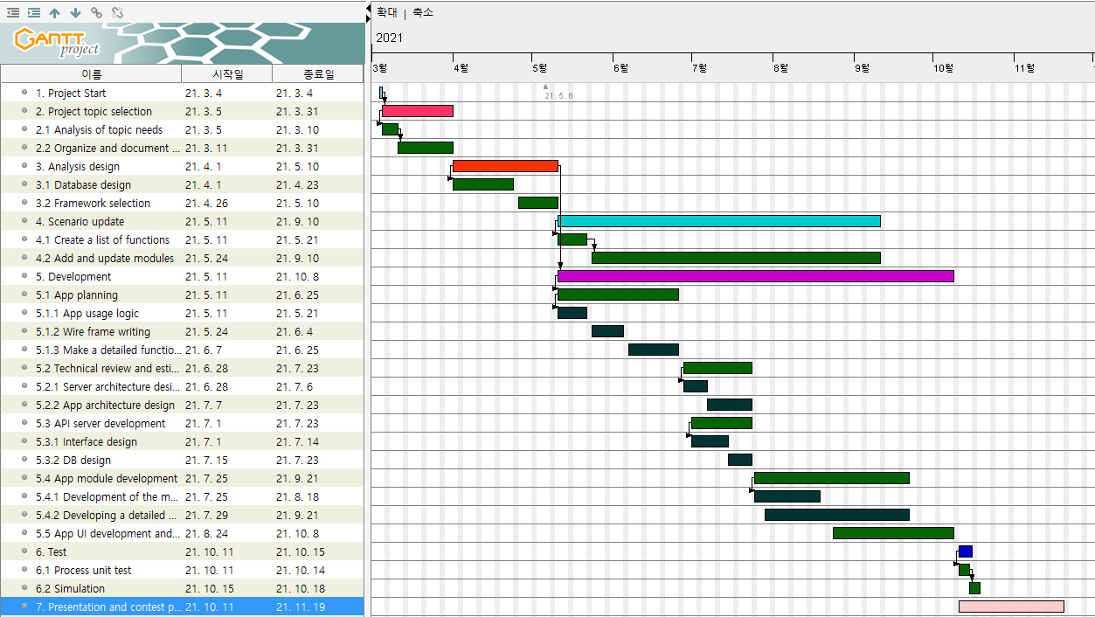
#5.
Service Development Process
Service Development Process
Notes:
1년간 진행하며 수행한 세부활동들을 간트차트를 통해 시각화해보았습니다.

Slide 9



#6.
Functional Specification
Functional Specification
Participants can view shared materials & schedules in group chats
Personal chat is available for information sharing among the same study participants
Job seeking study
Participants
Administer
Enter basic information such as company, number of people, and location to conduct the study
Overall study management including schedule and study member recruitment
Modify study information according to the situation
It filters/surfs studies that match the information (category / company / location, etc.) that the user is interested in.
Send a message of hope to participate in a study of interest
If the administer approves participation, he or she is invited to the group chat room as a member of the study and changed to participants in the study.
The contents entered/modified by the administer are displayed.
Interested in participating can obtain study direction information
Automatically open a group chat when opening a study
Interested in participating

Slide 10
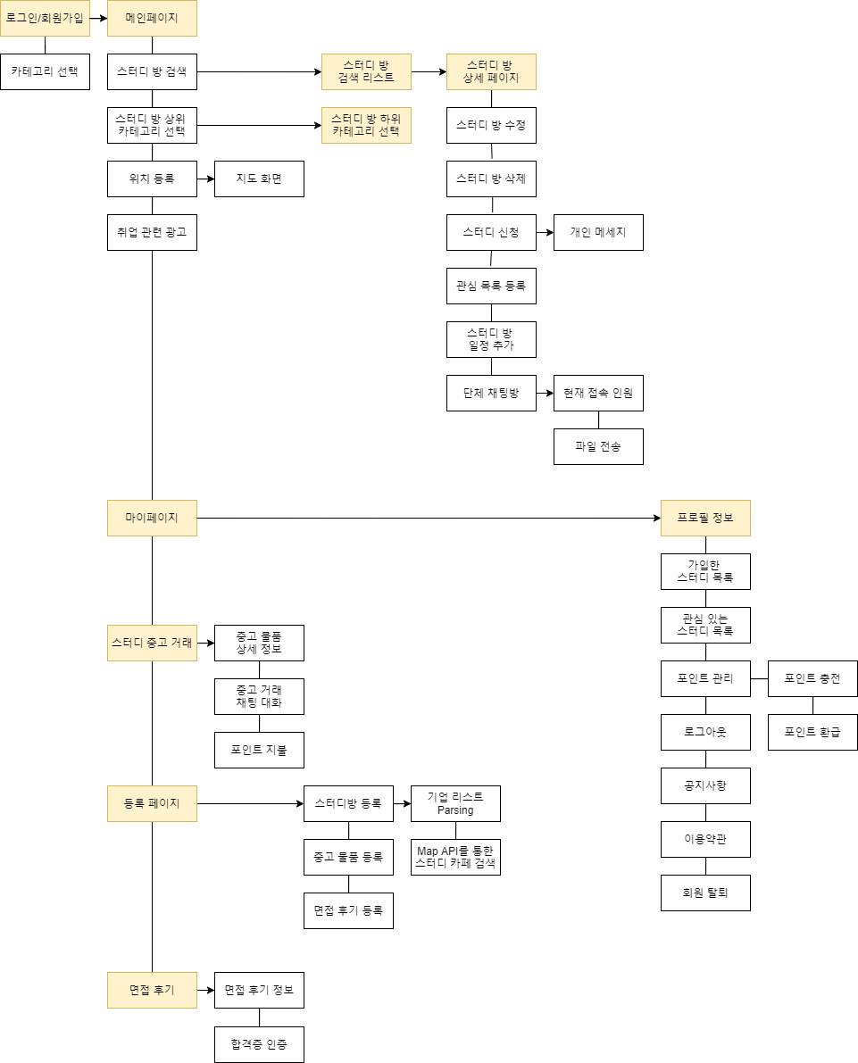
#7.
Menu Flow Chart
Menu Flow Chart
Personal information
This is a function that records and displays the user's activity log, such as profile picture, current location, wishlist, registered study list, registered materials, and points.
Job seeking study
It is focused on recruiting and conducting regional-based job seeking studies, which are the main functions of the service in relation to search, wishlist, detailed inquiry, modification, deletion, and group chat.
Second hands market
It is a used trading function created to easily trade unnecessary items, materials, and devices that are difficult to handle after the user gets a job.
Interview review
It is a service related to a space where users post posts to inform junior study members about their experiences after getting a job. Points that can be redeemed for cash are provided to revitalize the community.

Slide 11




#8.
System Configuration Technology
System Configuration Technology
Android
Firebase
Mobile operating system and software stack that includes operating systems and middleware for mobile phones and other portable devices, user interfaces, and standard applications (web browser, email client, short message service (SMS), and MMS).
It enables developers to write applications in Java and Kotlin languages, and provides a runtime library that can run compiled bytecodes.
Realtime database: The fire base stores data in the form of JSON in the NoSql cloud database and synchronizes the data to the client in real time.
Storage : It stores content such as images, audio, video, etc. produced by a user and provides stored content as needed.
Google API
Client-Server Communication
LOGIN API
MAP API
AD mobs
User platform : Android
Android foreground : WebSocket,
HTTP long-polling
Android background : FCM

Slide 12
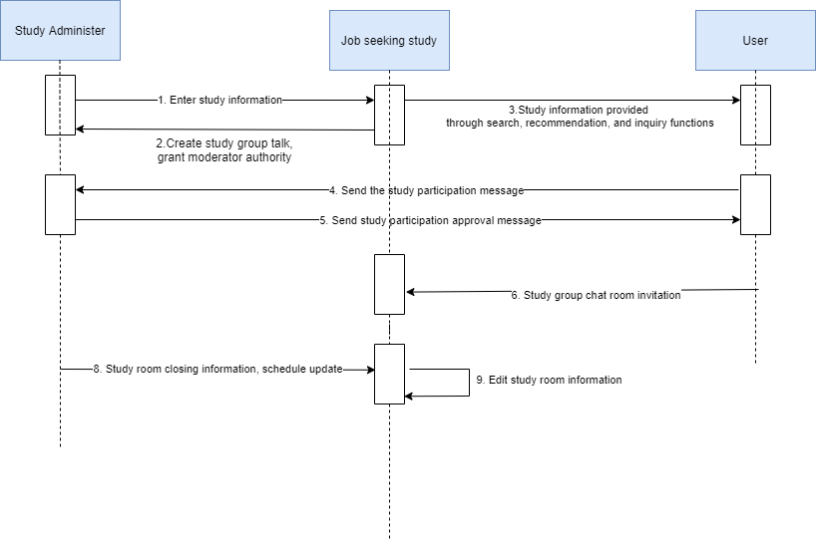
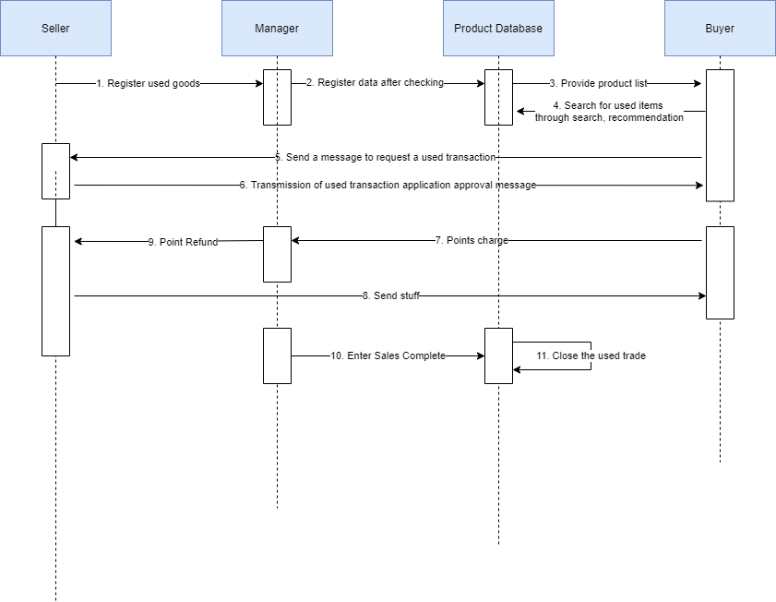
#9.
Sequence Diagram
Sequence Diagram
< Study creation - Inquiry - Application for participation - Completed participation >
< Point redemption and refund & Secons hand trade>
Notes:
앞에 use case diagram

Slide 13
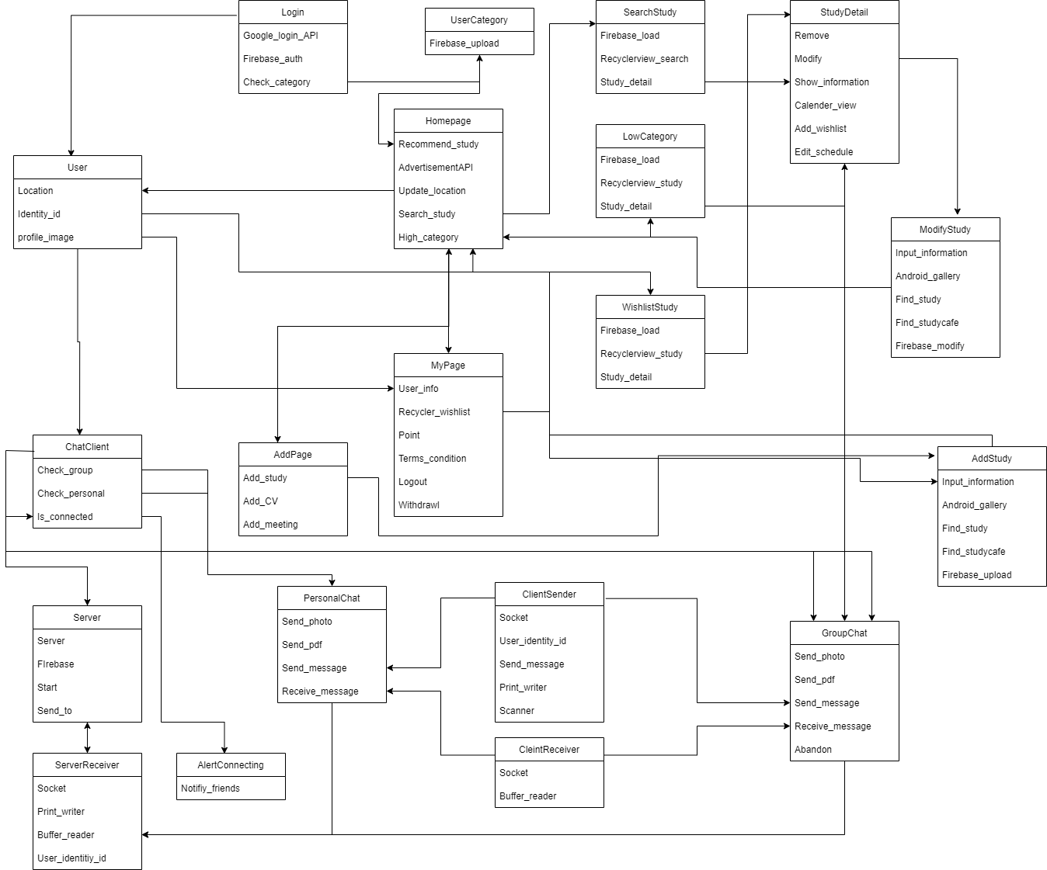
#10.
Class Diagram
Class Diagram

Slide 14
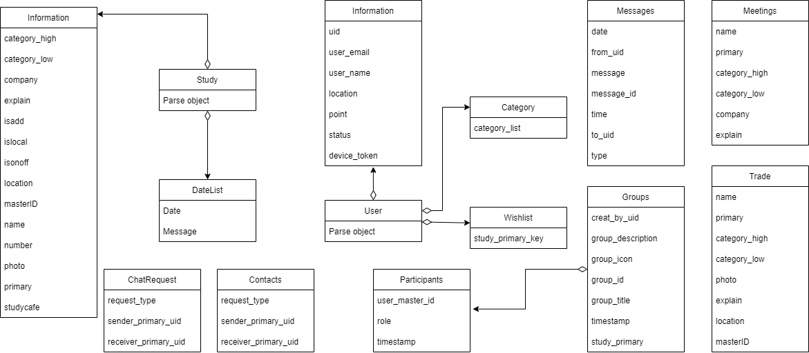
#11.
Database Structure
Database Structure
User - Tree structure containing user information
Study - Tree structure containing information related to the study room.
It is also related to Firebase Storage.
Trade - Tree structure containing information related to used transactions
Meetings - Tree structure containing information related to interview reviews
Groups, Messages, ChatRequest,Contacts
- Database built for chat service

Slide 15
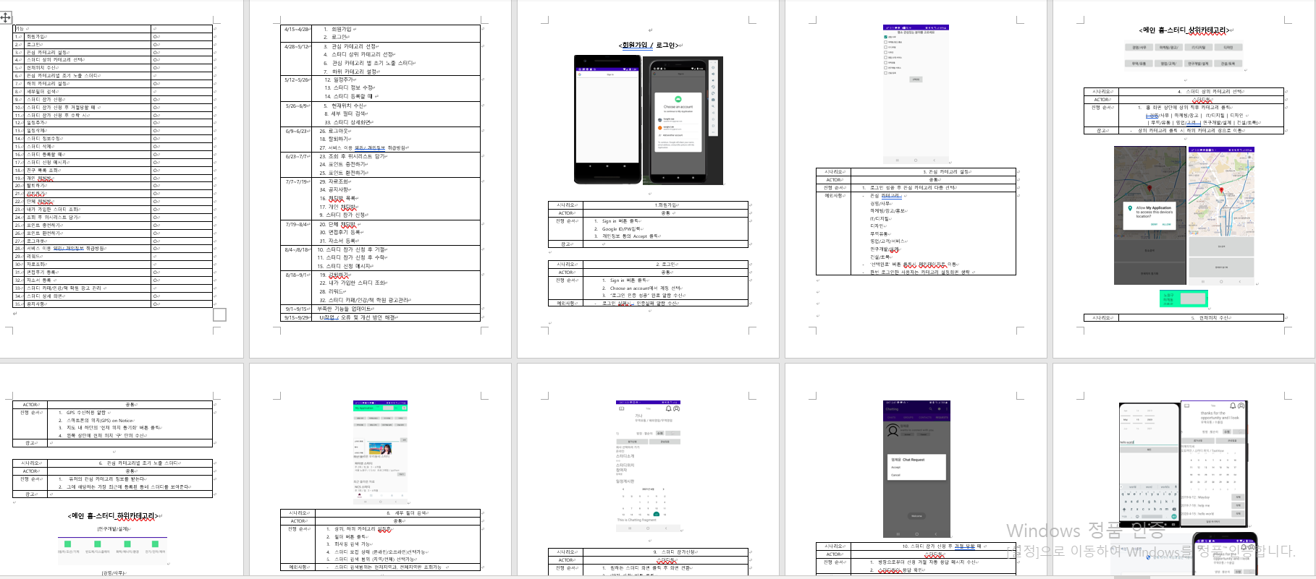
#12.
Service Scenario
Service Scenario

Slide 16
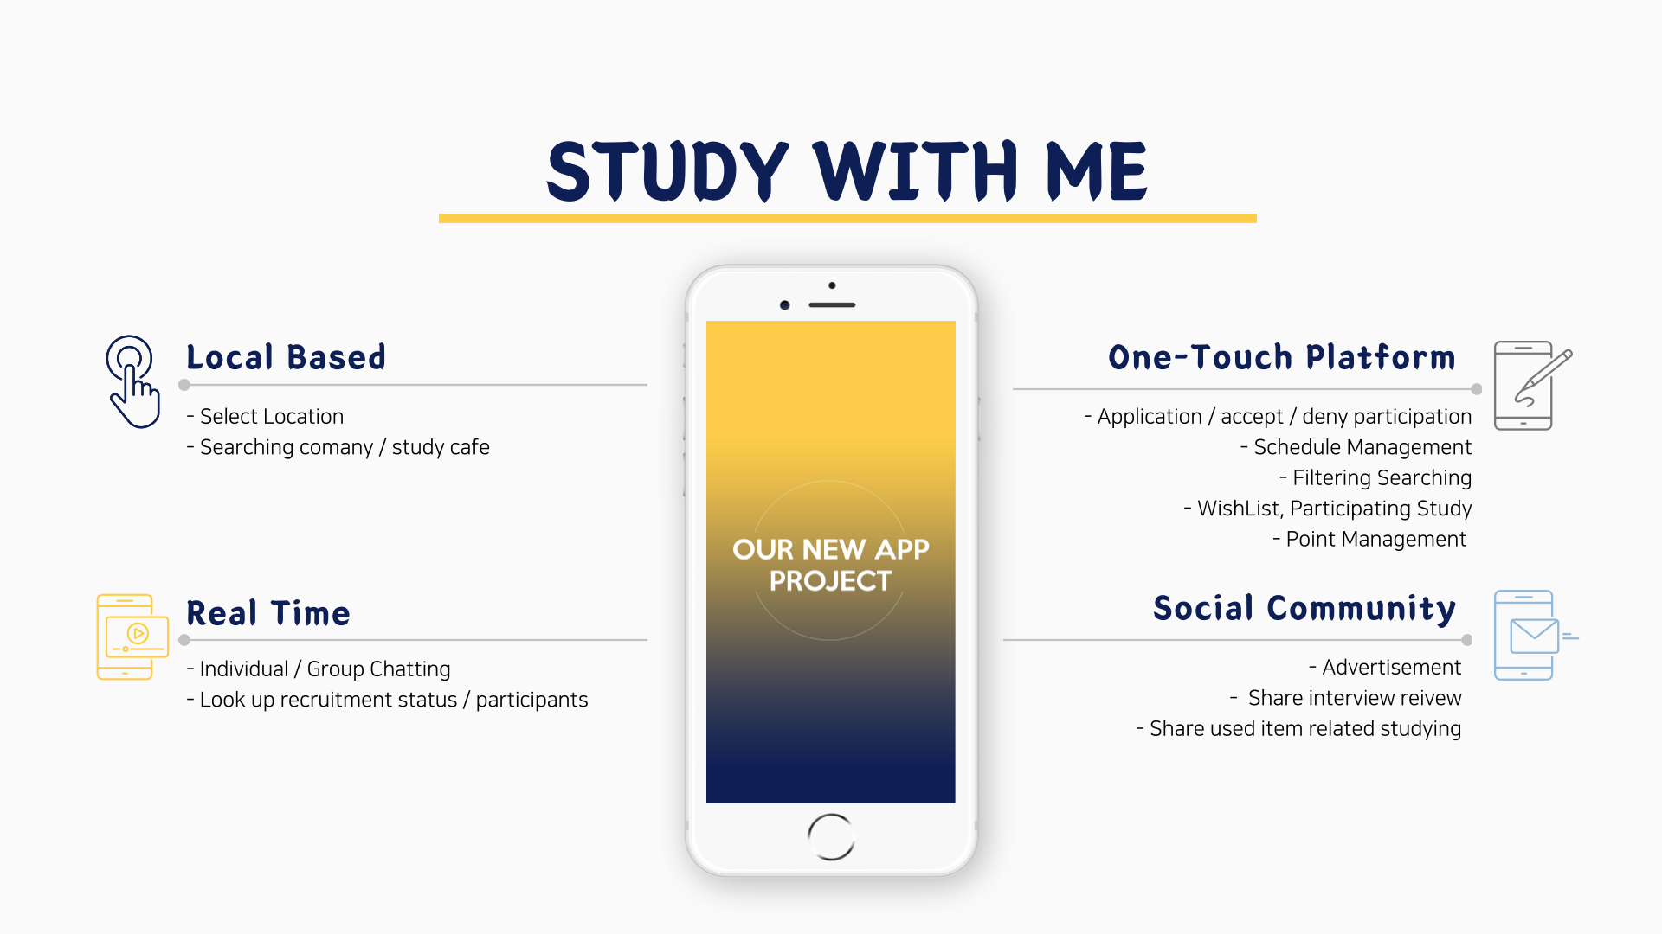
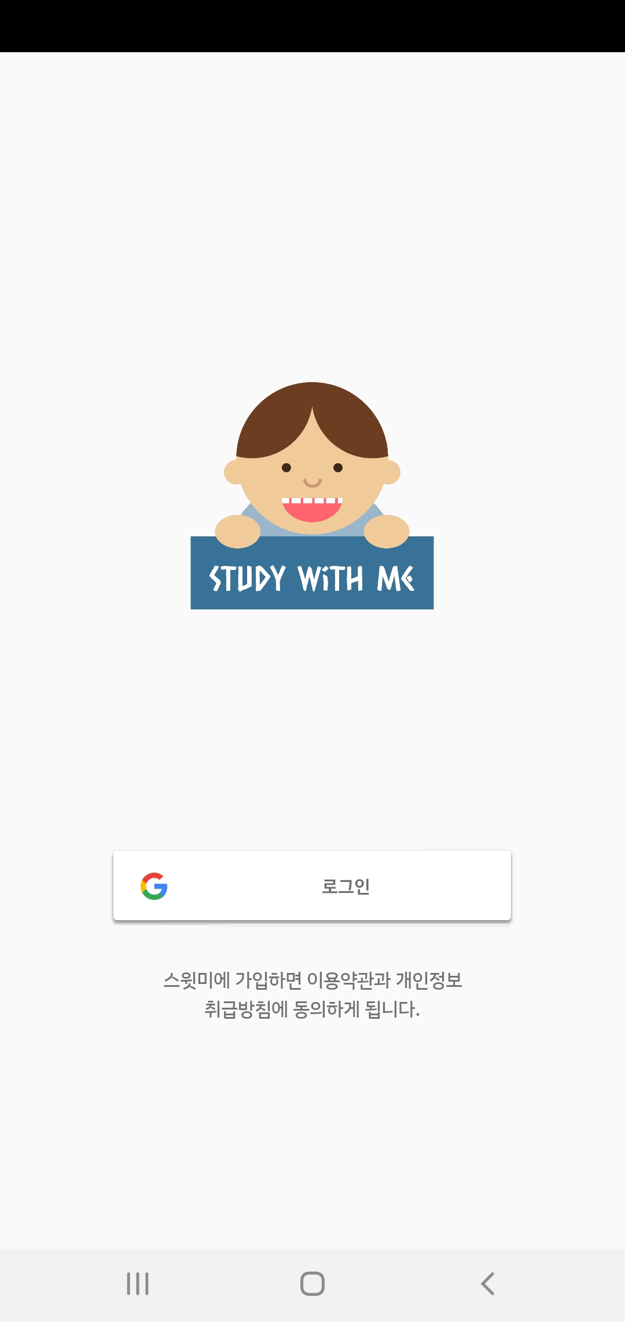

Slide 17
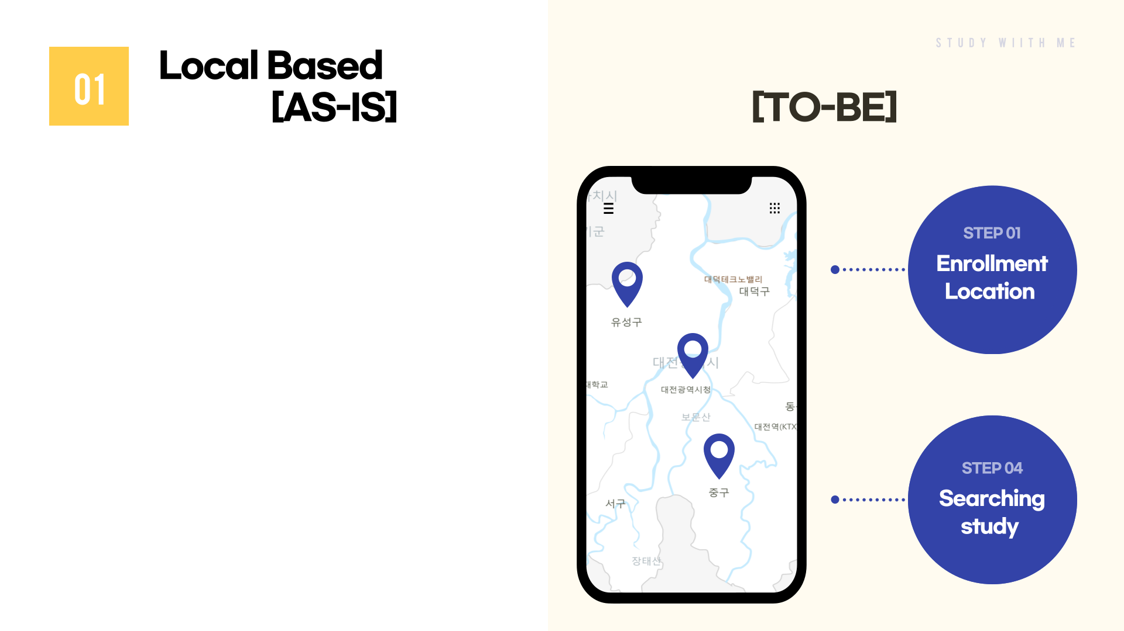
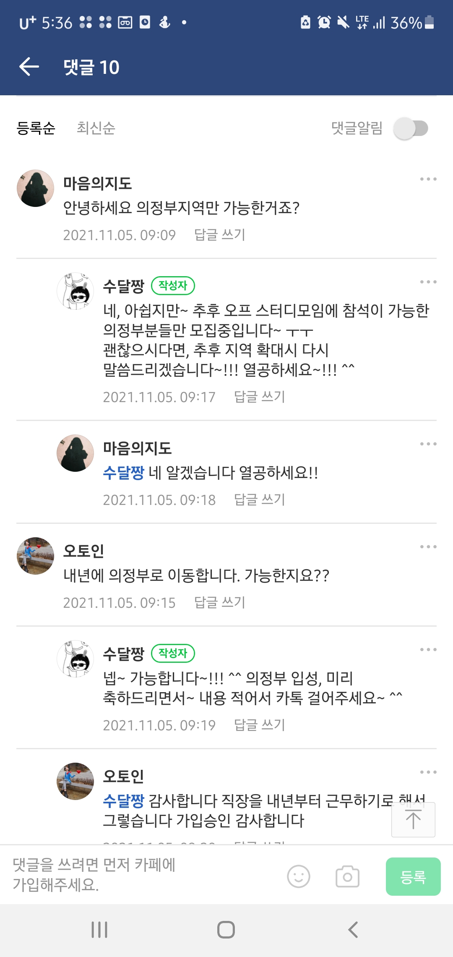
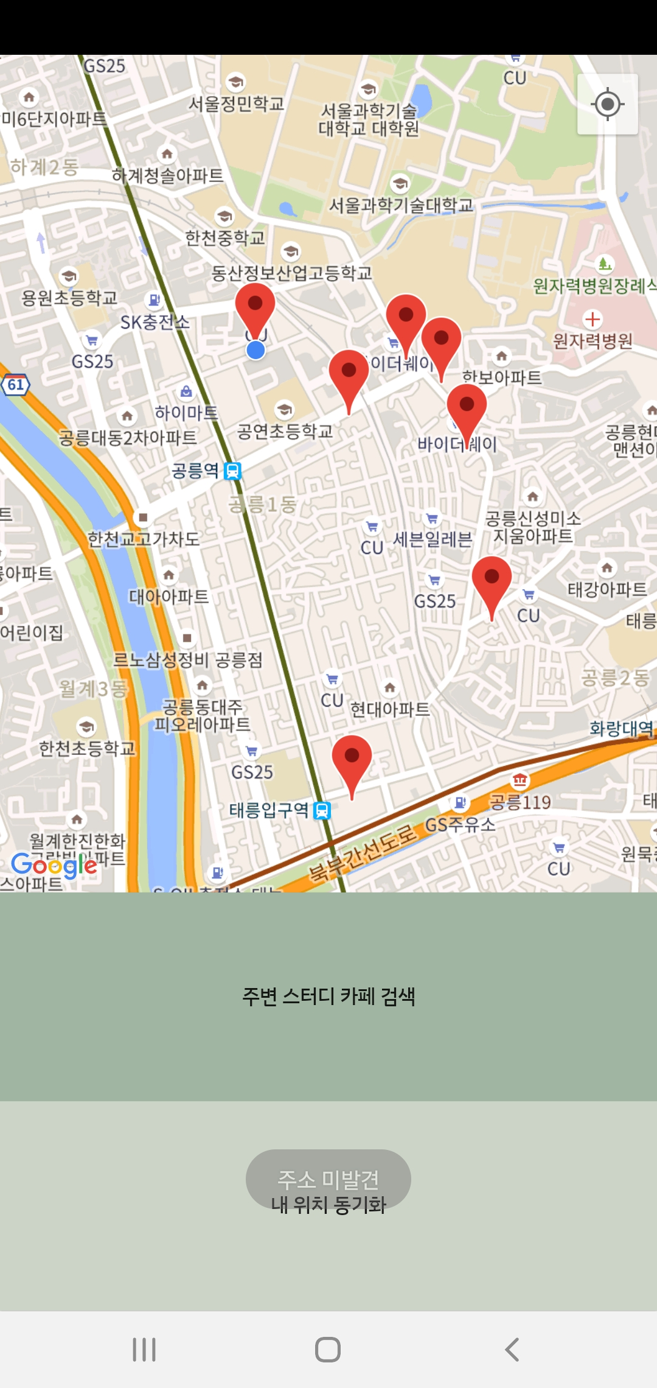
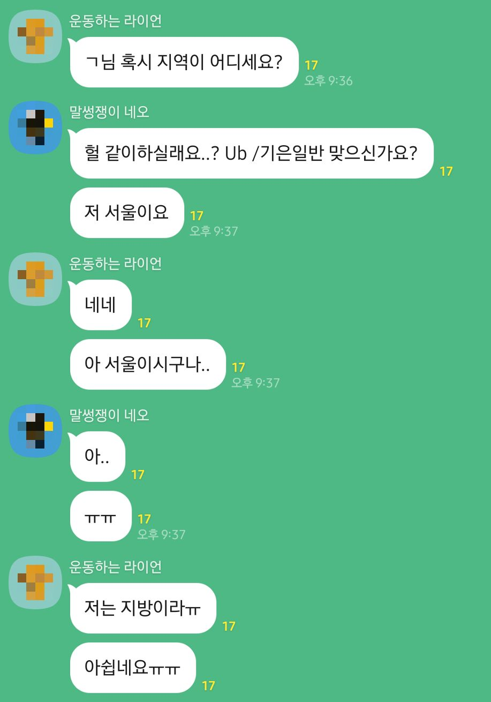

Slide 18
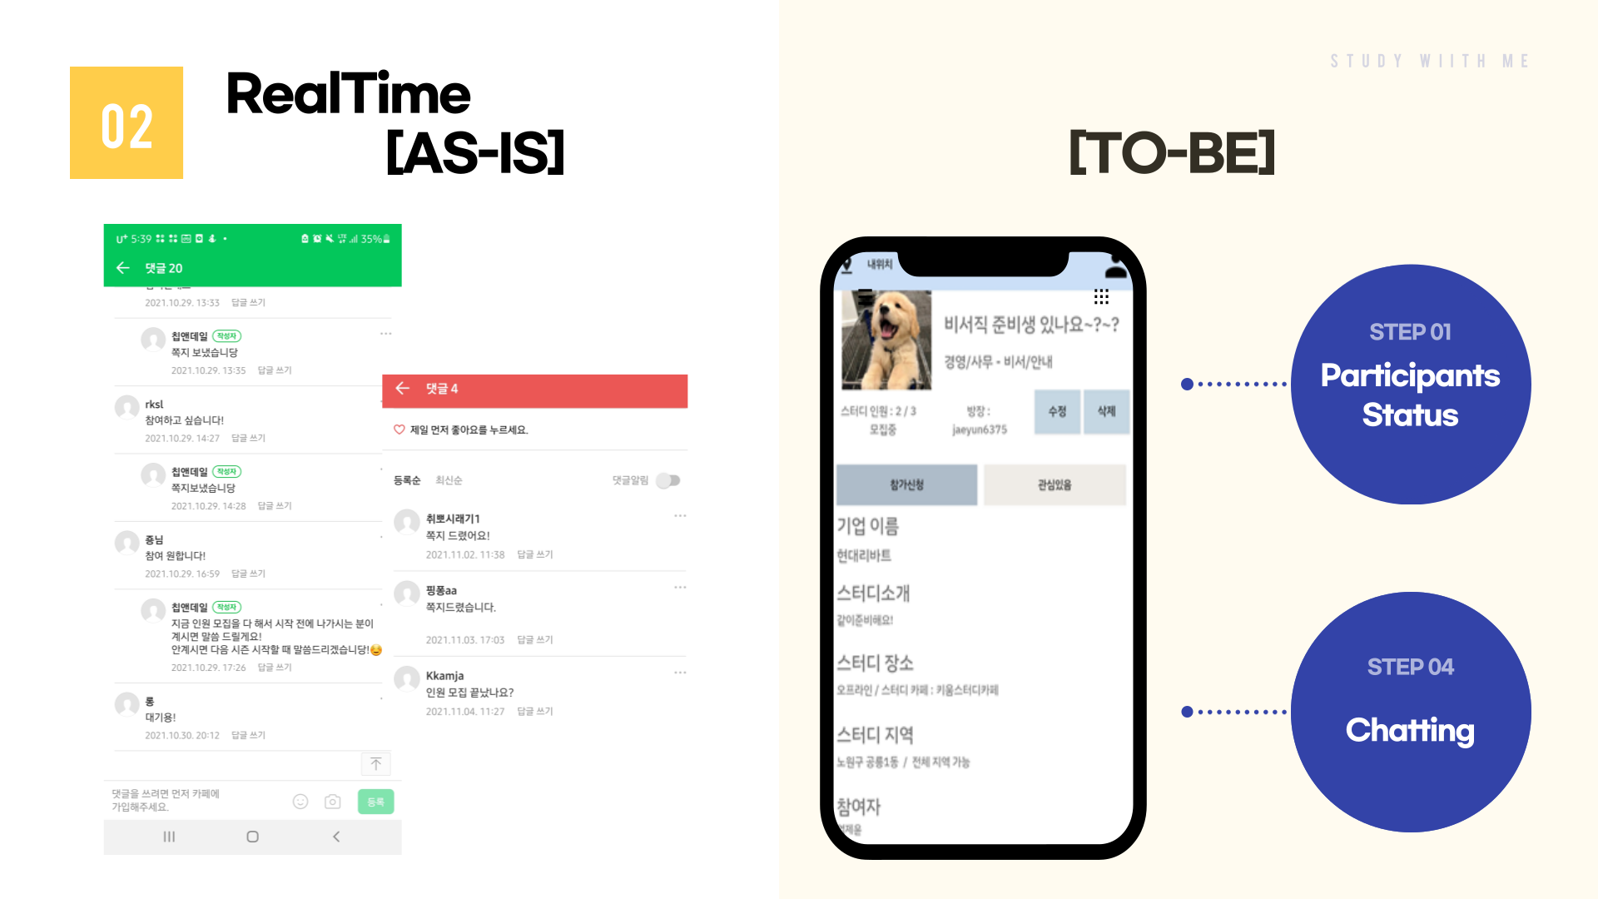

Slide 19

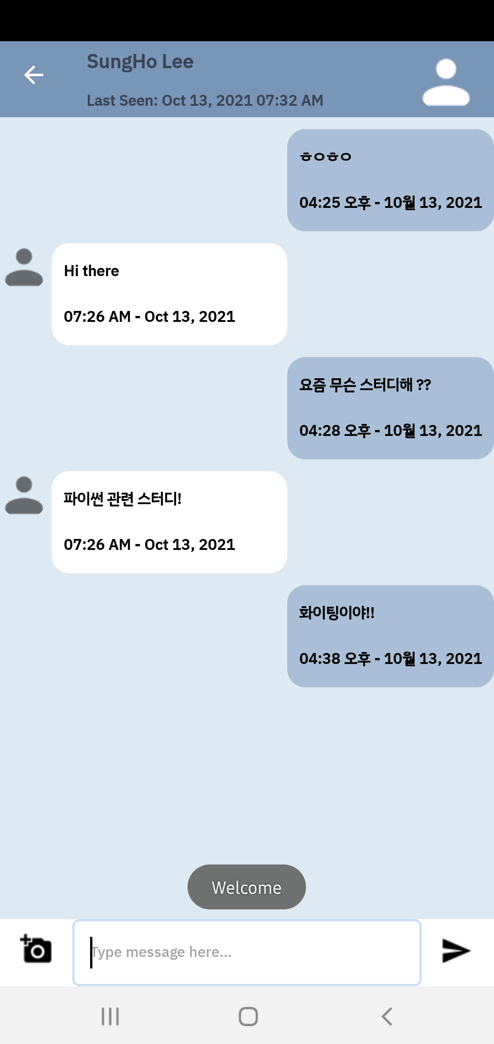
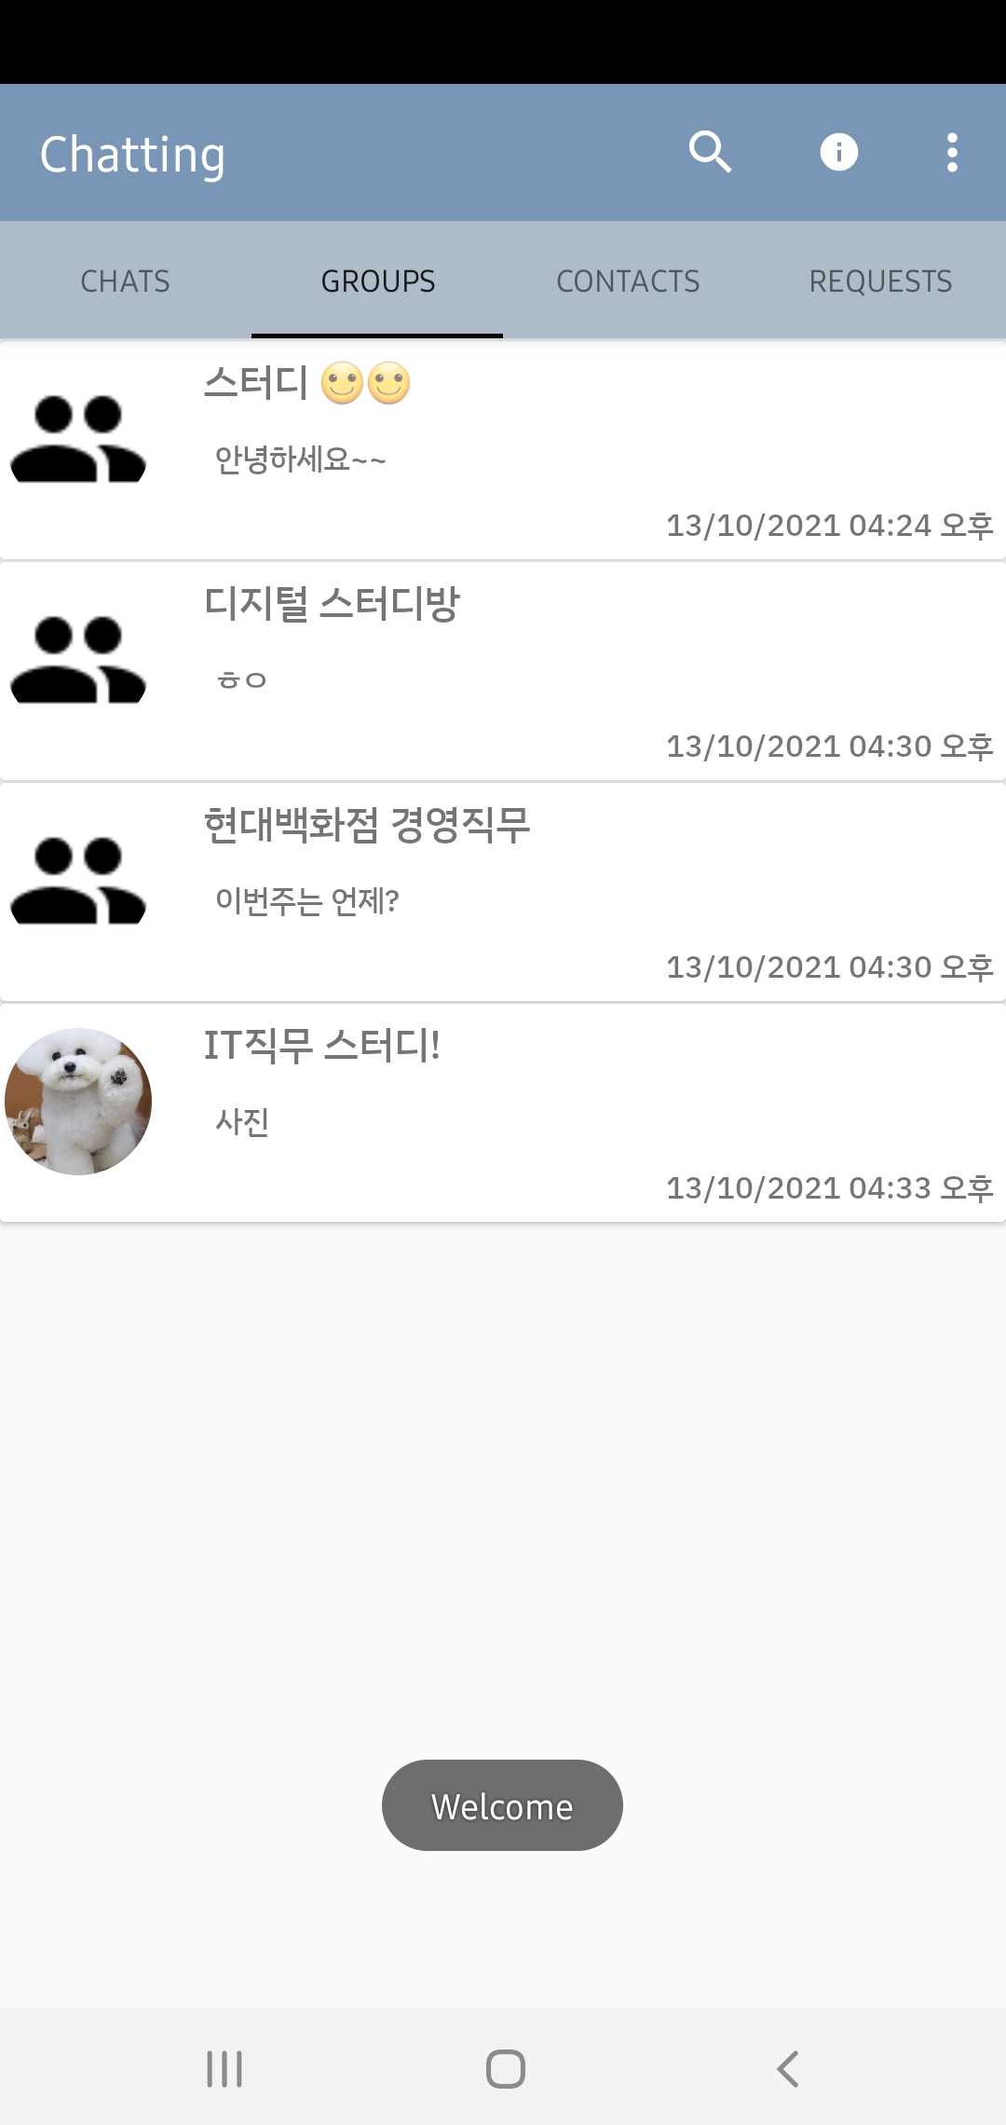
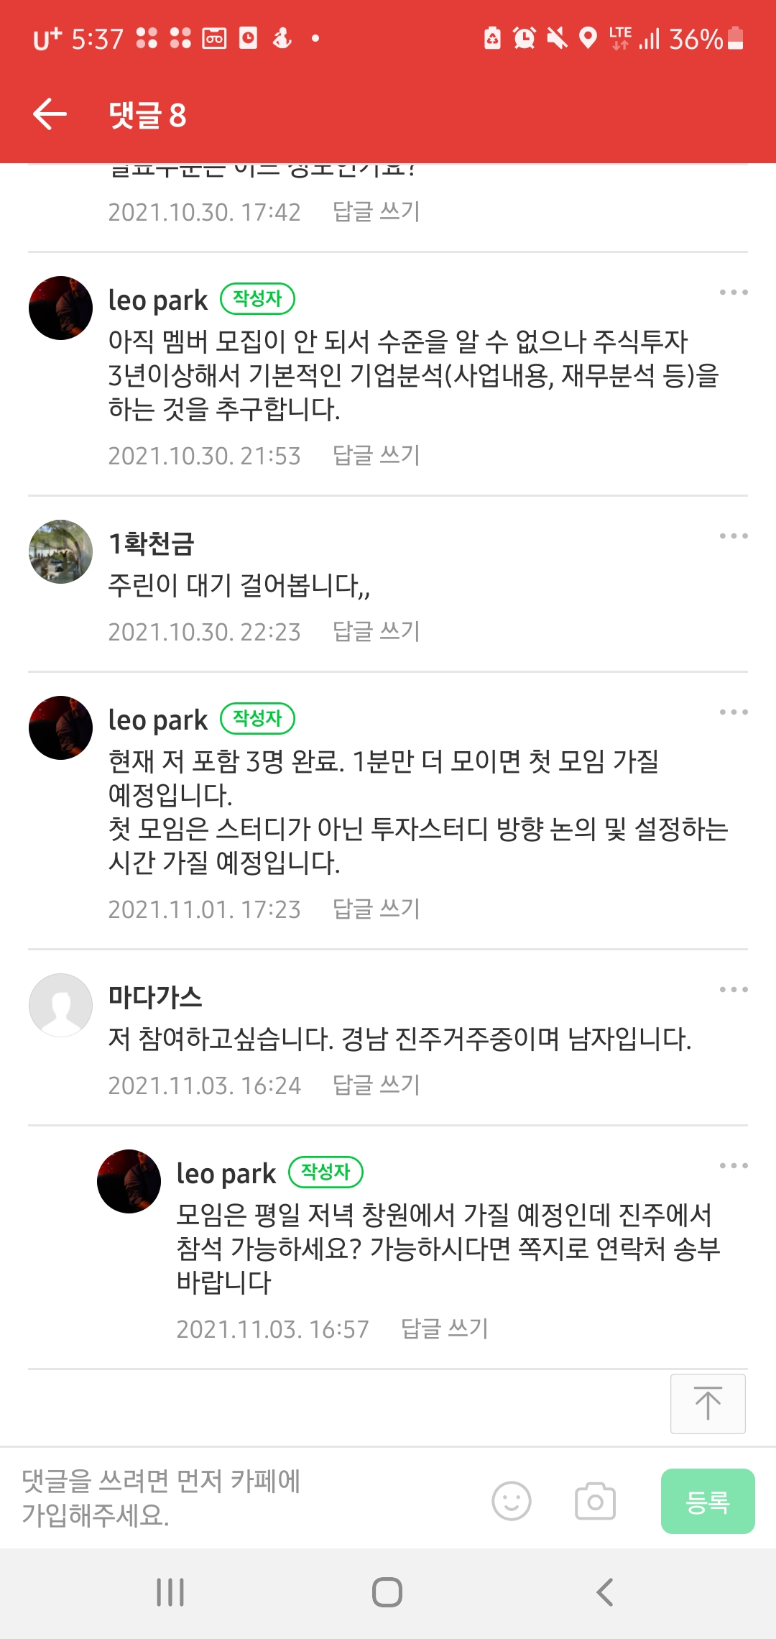
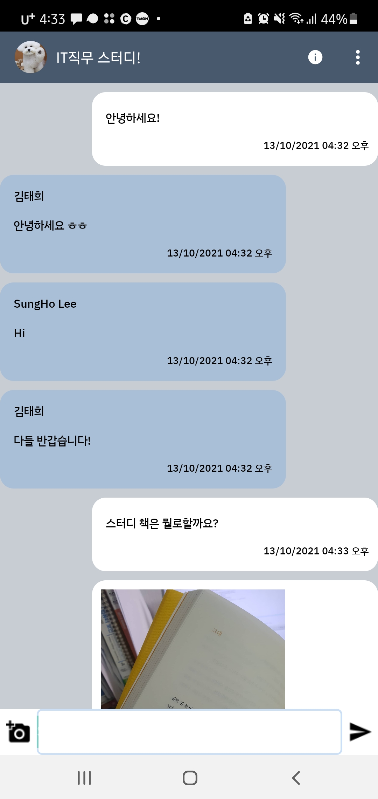
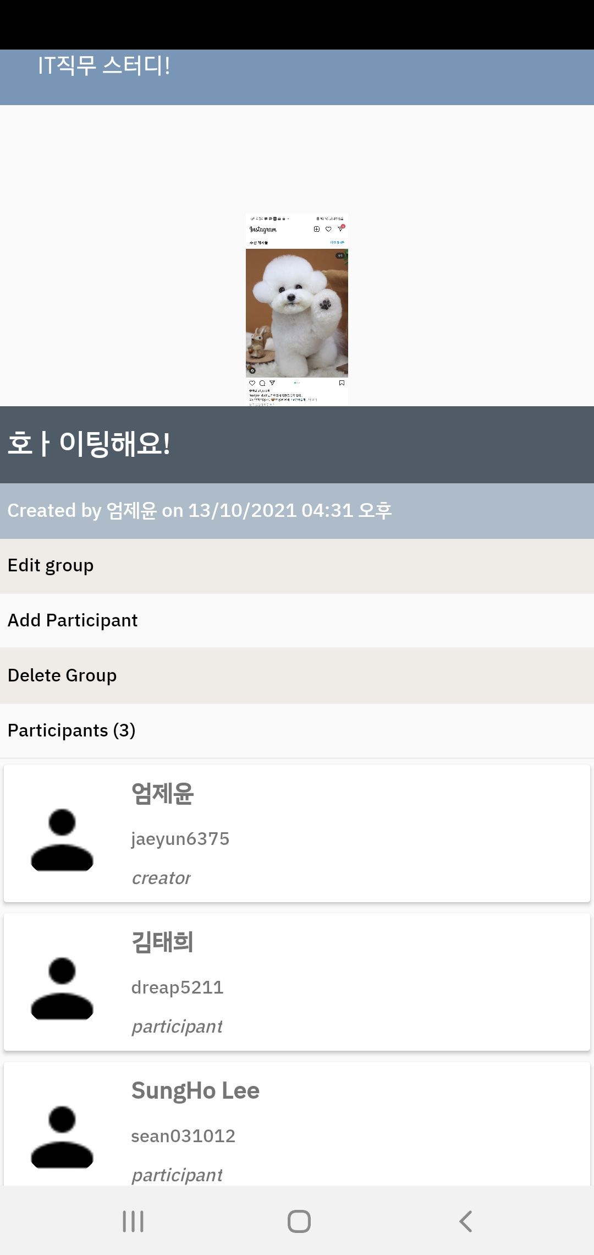
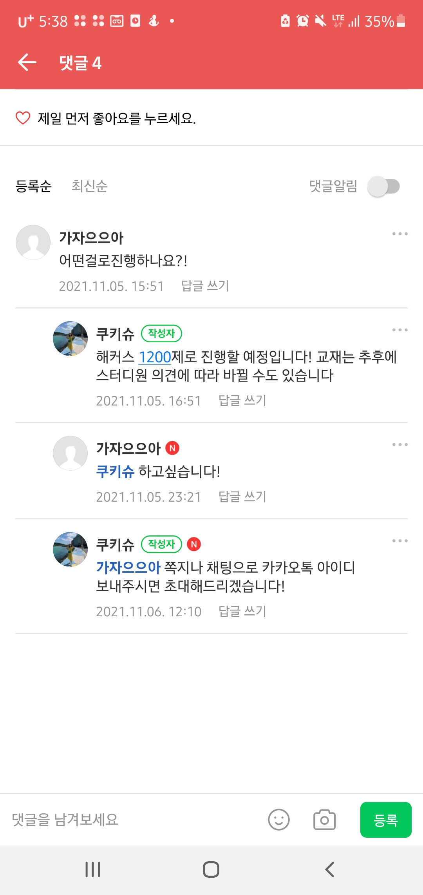




Slide 20
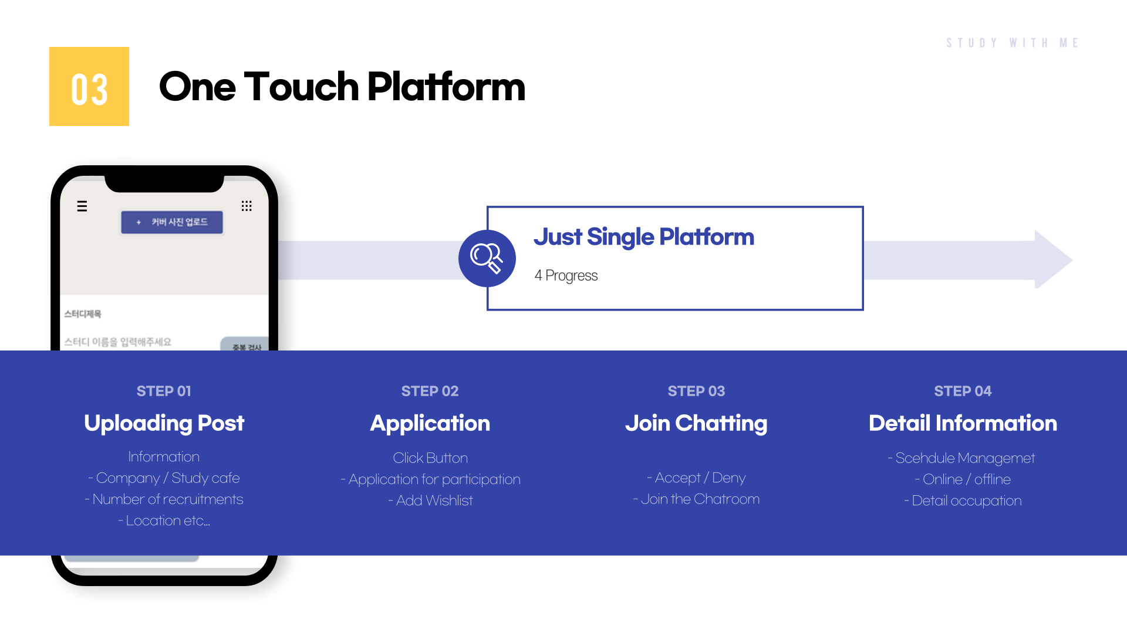

Slide 21
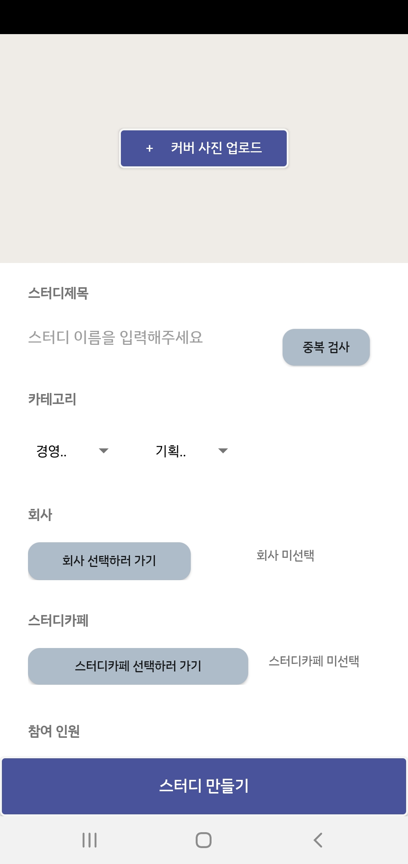
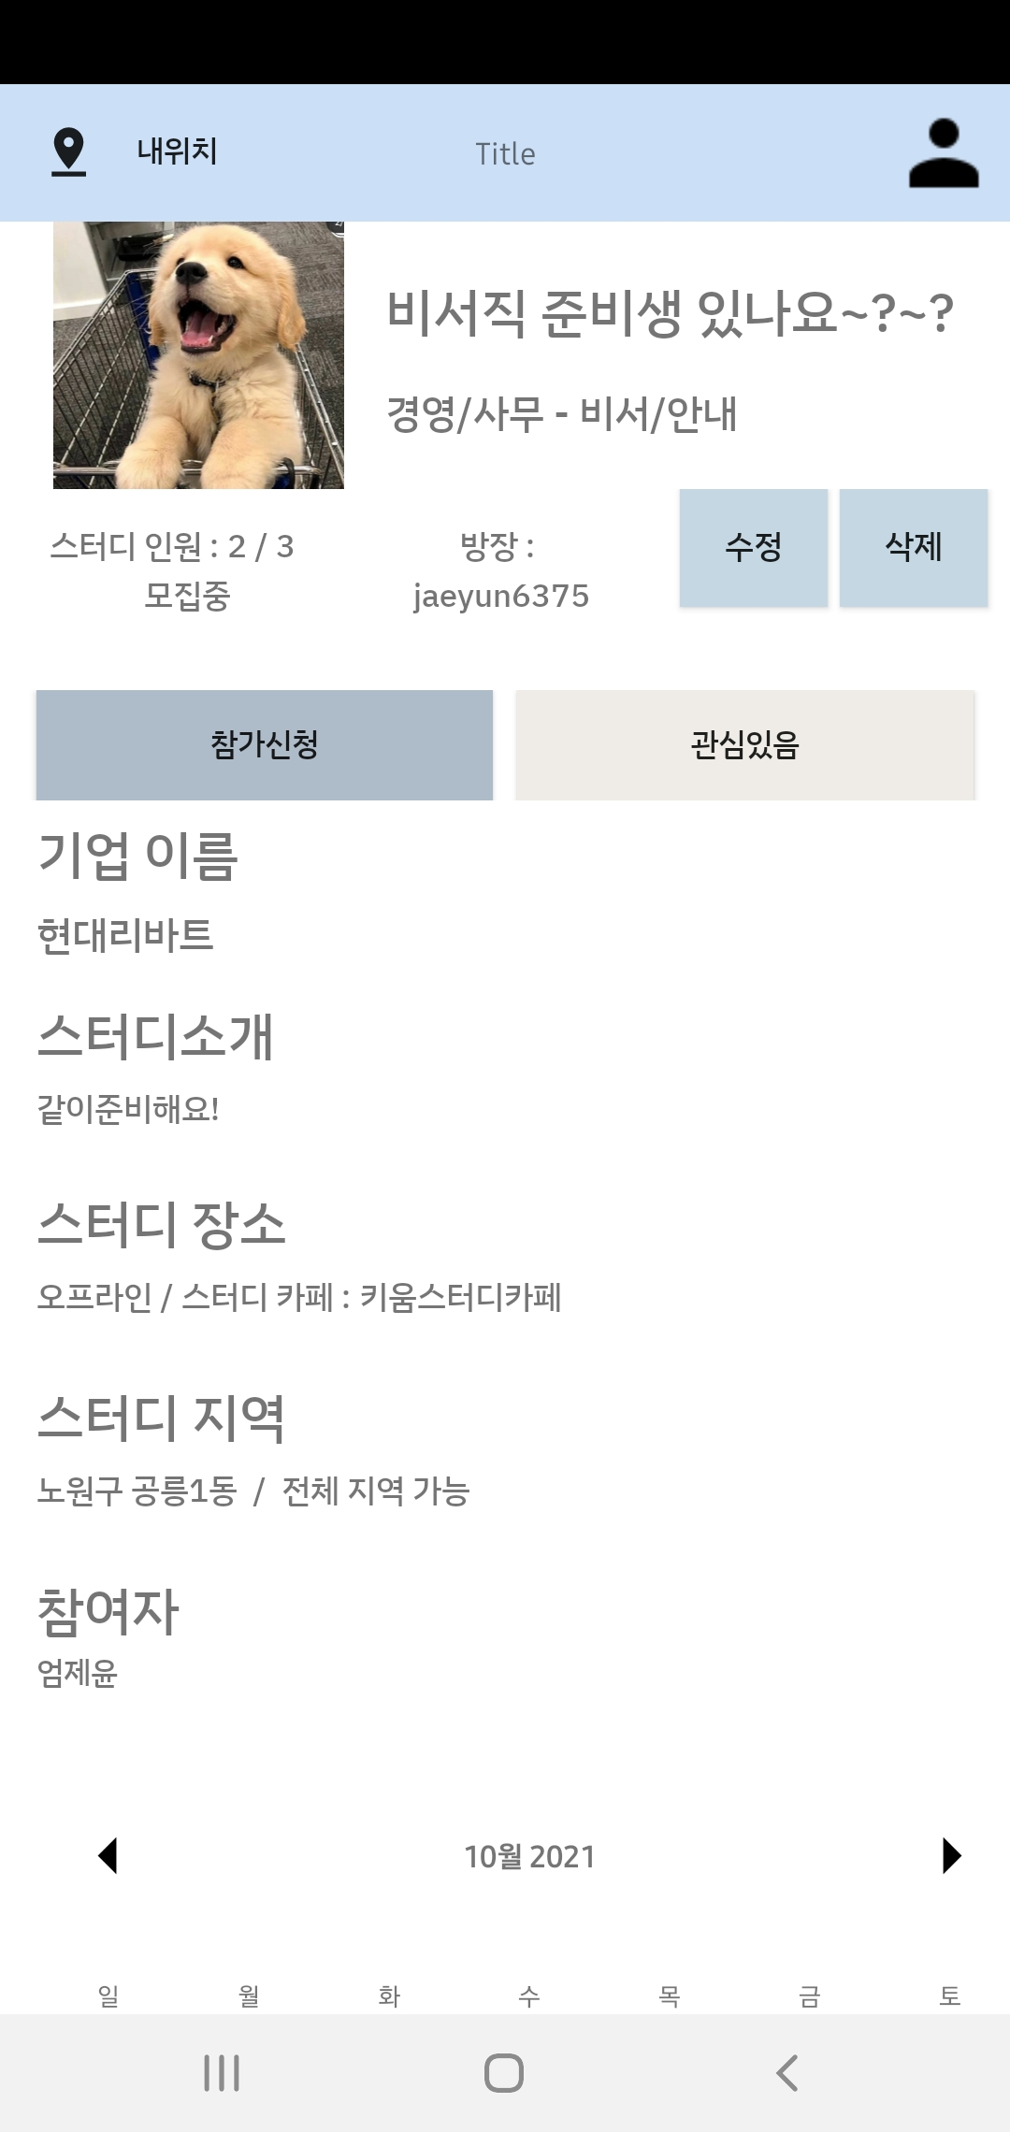
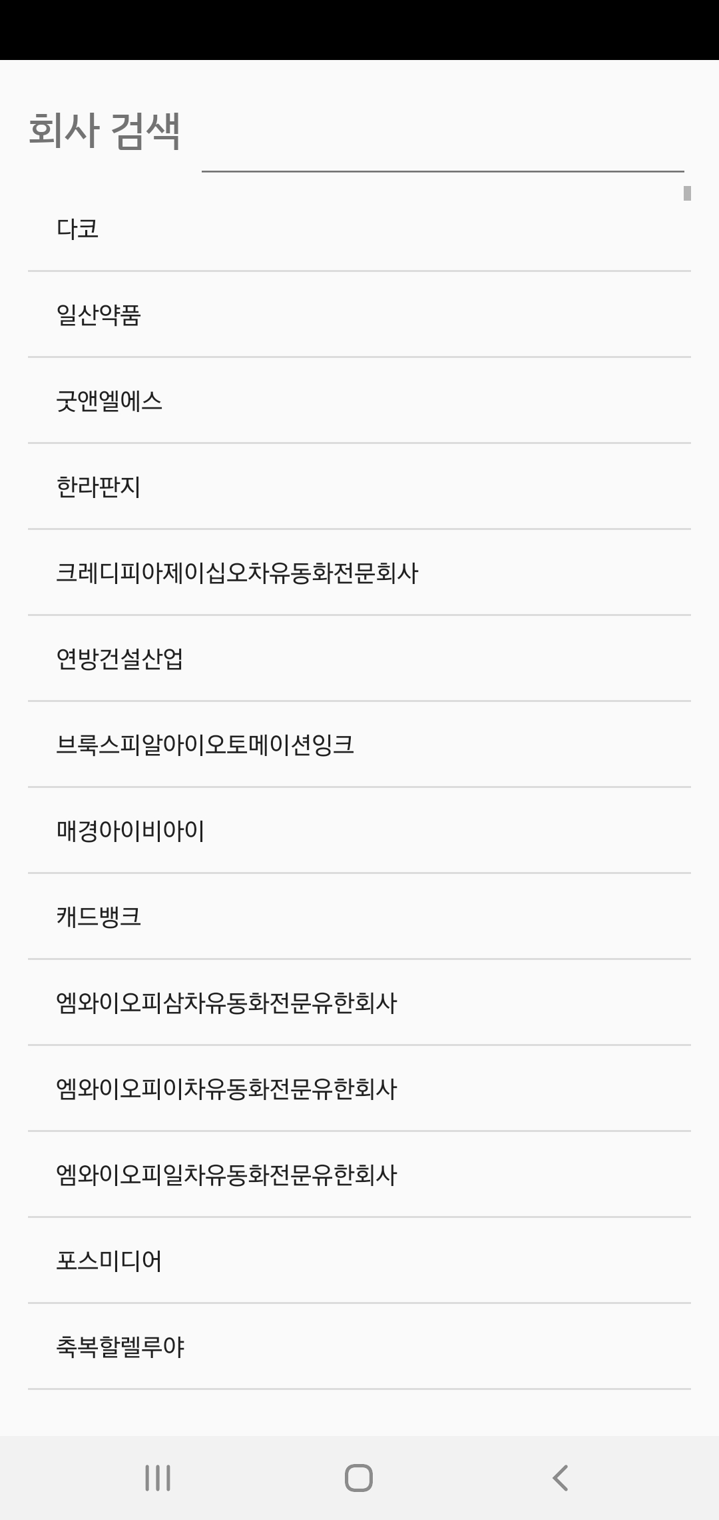
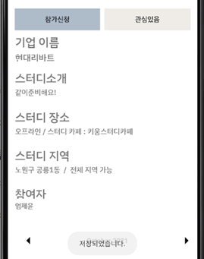

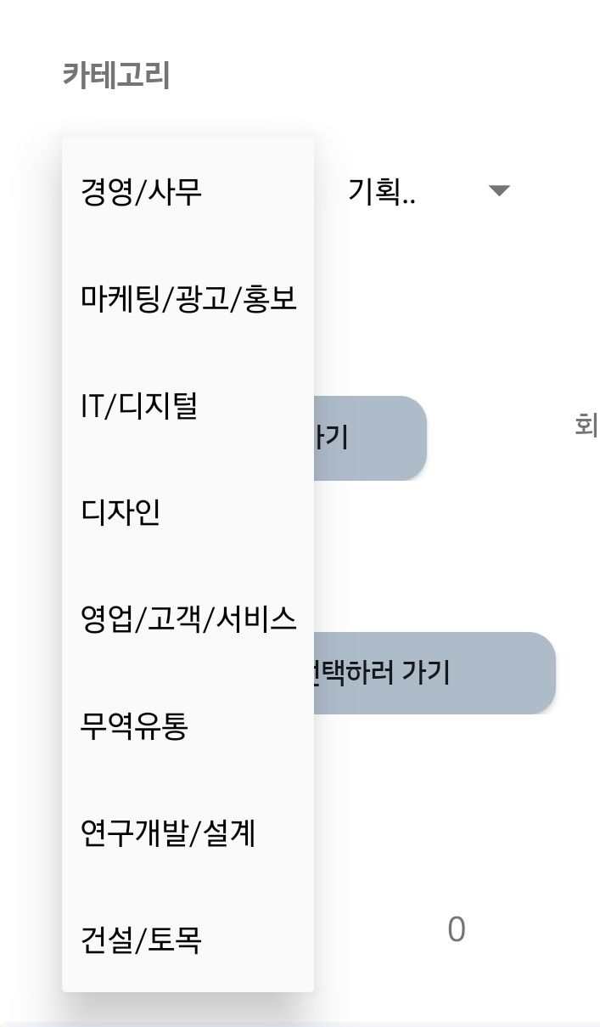

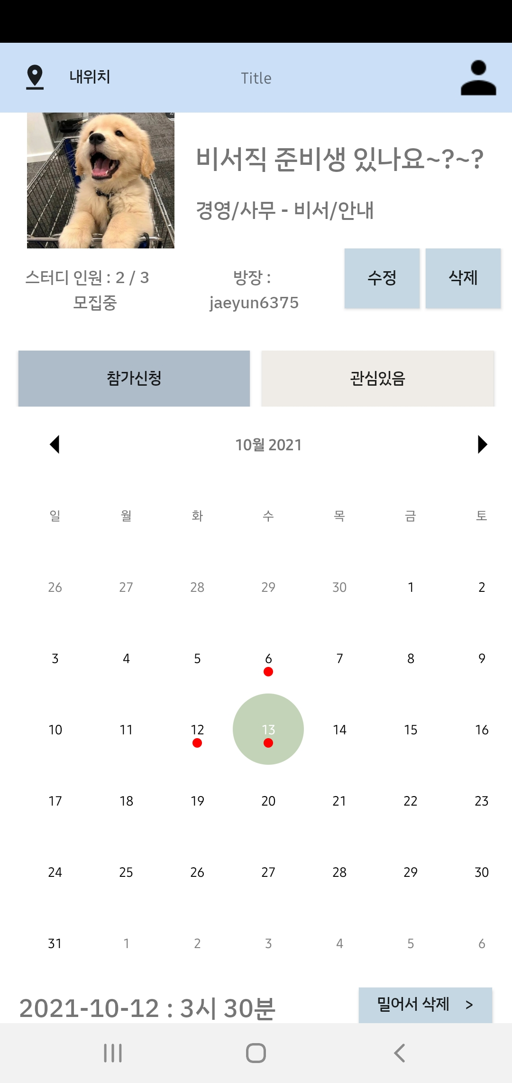
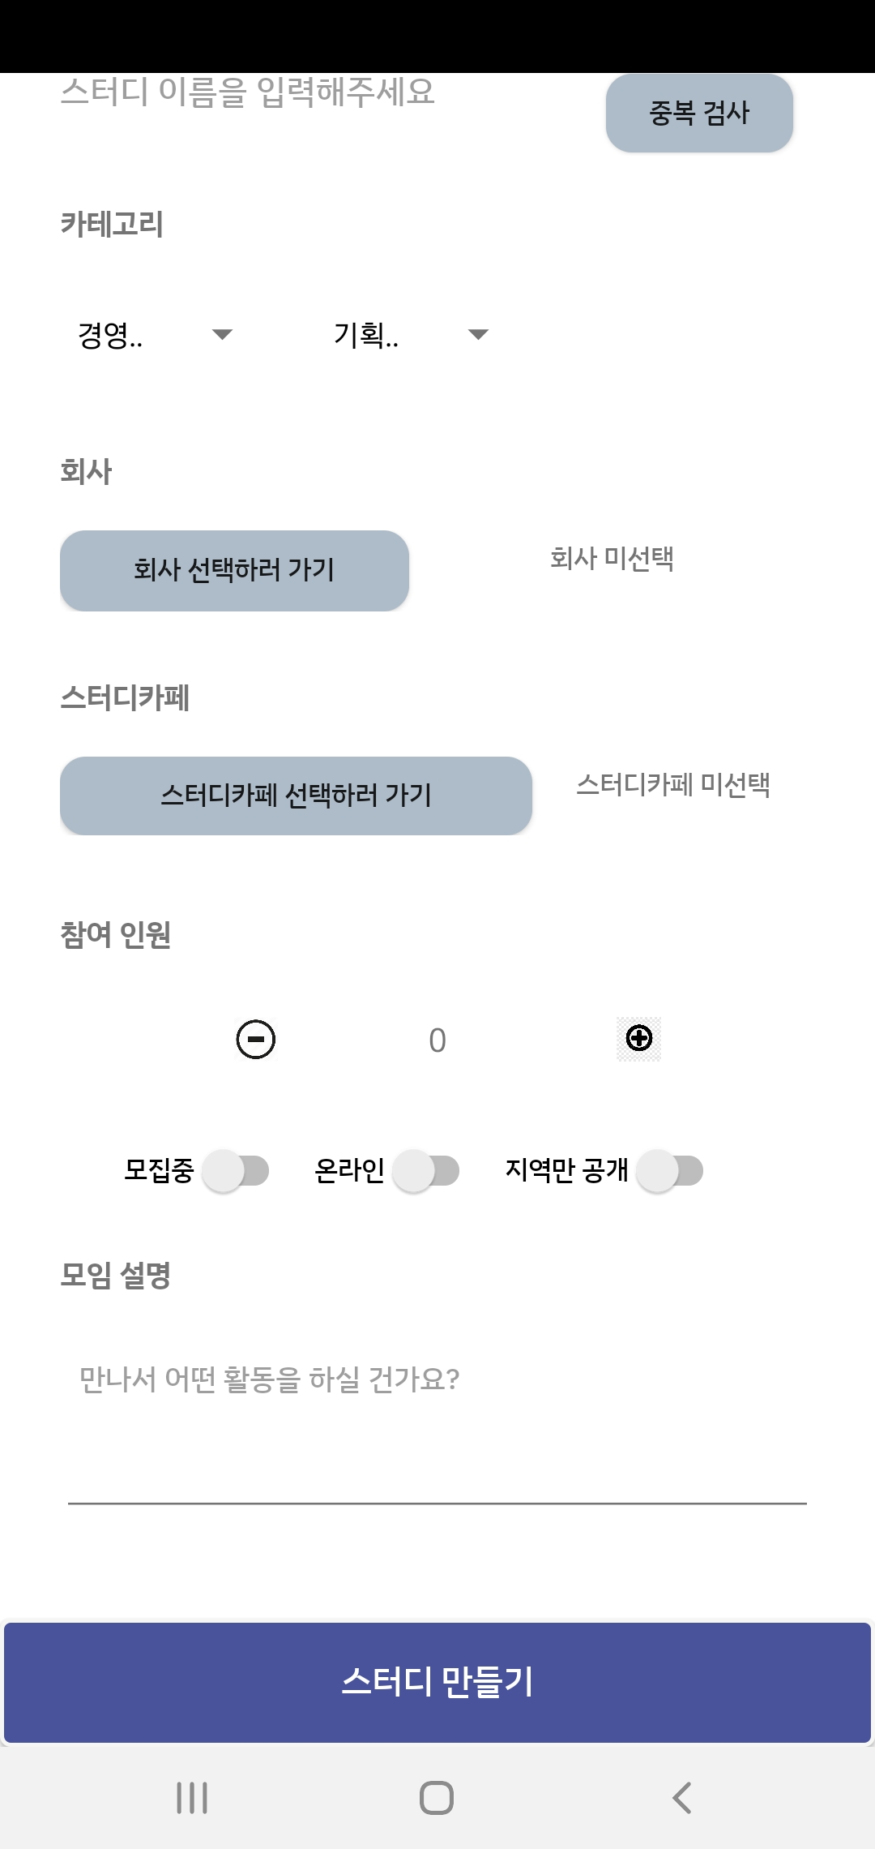
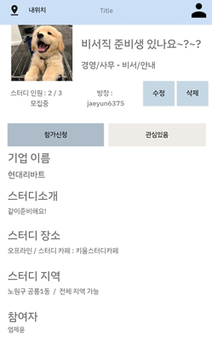
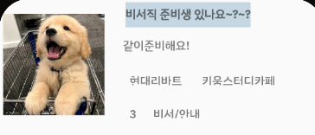
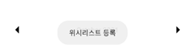
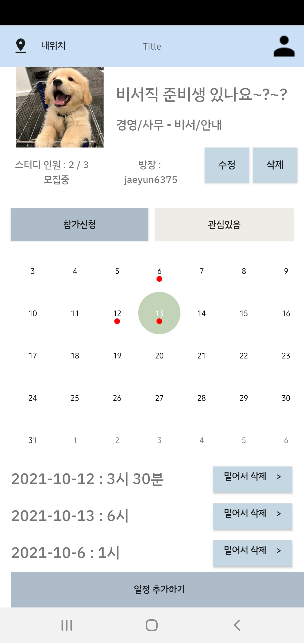
[Application]
[Searching Company]
Sending to
Administer
[Wishlist]
[Searching Study Café]
Click
-> MyPage
[ WishList]

Slide 22
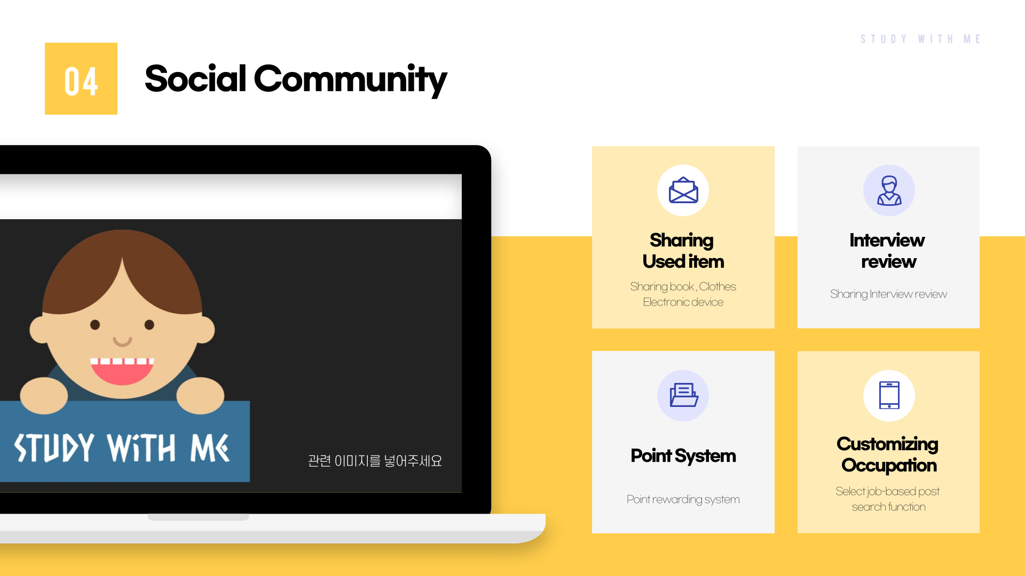

Slide 23
#13.
Conclusion
Conclusion
Strength
Location-based Service
The domestic location information service market reached KRW 2.51 trillion,
up 1.7 times from the previous year.
Study Cafe Demand
Generation z prefers study cafes.
An increasing number of users are looking for study cafes instead of library and cafes because the cost is low and coffee and snacks are available..
Used market outlook
As the perception of ‘used trade’ changes, the outlook for the seconds hand market is expected to be bright
Notes:
위치기반 서비스는 최초로 만들었다
기대효과 ->
추후연구
3개 블록으로 (소제목달아서)

Slide 24
#13.
Conclusion
Conclusion
기대 효과
Local advertising
High efficiency because you can select and advertise only the desired area, and you can set the exposure period freely to avoid wasting budget
For local small business owners who run study cafes and bookstores, local advertising is the most appropriate means to achieve publicity without incurring large costs.
Resolving the phenomenon of concentration in the Seoul area
Resolving the limitations of job-seeking activities and study registration for job-seeking students located in rural areas
Notes:
위치기반 서비스는 최초로 만들었다
기대효과 ->
추후연구
3개 블록으로 (소제목달아서)

Slide 25
#13.
Conclusion
Conclusion
추후 연구
User trust verification
Provides an intelligent and automated solution by introducing an automatic reliability verification function based on user data
Lecture/mentoring for users
Promotion of activities by recruiting participants through special employment lectures/mentoring recruitment conducted by schools and companies
Reservation/Payment Service
Introduce study cafe reservation and payment process within the app to use the service smoothly
(Activation of cafe advertisement)
Notes:
위치기반 서비스는 최초로 만들었다
기대효과 ->
추후연구
3개 블록으로 (소제목달아서)

Slide 26
#13.
Conclusion
Conclusion
Location-based Service
The domestic location information service market reached KRW 2.51 trillion,
up 1.7 times from the previous year.
User trust verification
Provides an intelligent and automated solution by introducing an automatic reliability verification function based on user data
Local advertising
High efficiency because you can select and advertise only the desired area, and you can set the exposure period freely to avoid wasting budget
For local small business owners who run study cafes and bookstores, local advertising is the most appropriate means to achieve publicity without incurring large costs.
Study Cafe Demand
Generation z prefers study cafes.
An increasing number of users are looking for study cafes instead of library and cafes because the cost is low and coffee and snacks are available..
Lecture/mentoring for users
Promotion of activities by recruiting participants through special employment lectures/mentoring recruitment conducted by schools and companies
Resolving the phenomenon of concentration in the Seoul area
Resolving the limitations of job-seeking activities and study registration for job-seeking students located in rural areas
Used market outlook
As the perception of ‘used trade’ changes, the outlook for the seconds hand market is expected to be bright
Reservation/Payment Service
Introduce study cafe reservation and payment process within the app to use the service smoothly
(Activation of cafe advertisement)
Notes:
위치기반 서비스는 최초로 만들었다
기대효과 ->
추후연구
3개 블록으로 (소제목달아서)

Slide 27
SWM
2021 Capstone Design Project Final
THANK YOU
THANK YOU

